Slide 1

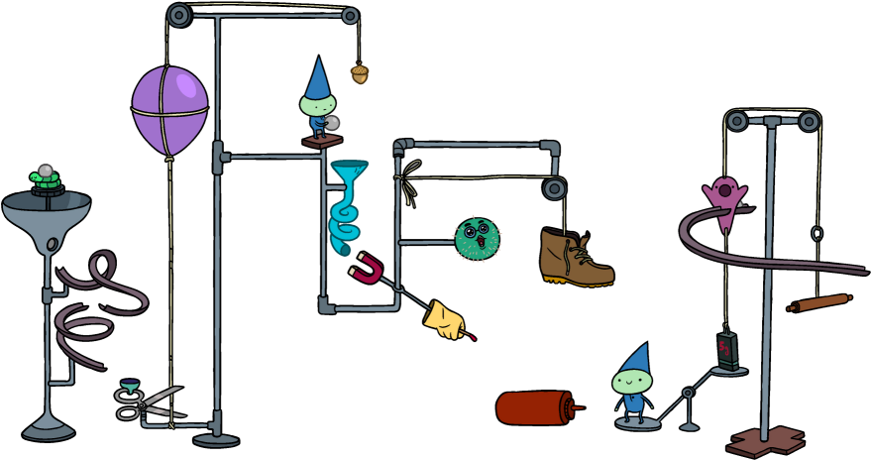
Rube Goldberg Team
Midpoint Presentation
Fall 2019
Jassem Alhaddad (Project Manager)
Ali Alrashidi (Client Contact)
Omar Aldhafeeri (Web Developer)
Ali Almari (Documents Manager)
Mohammed Albanaqi (Equipment Manager)
Abdullah Alsayeh (Budget Liaison)

Slide 2
Overview
Project Description
Labeled Image
Updates
CAD Model
Moving Forward
Schedule (Gantt Chart)
Budget
BOM
Reference
Jassem Alhaddad

Slide 3
Project Description
Rube Goldberg is a machine that performs a very simple task in a very complex fashion, usually including a chain reaction.
The objective is to create a reliable and resettable machine of Rube Goldberg steps.
Jassem Alhaddad

Slide 4
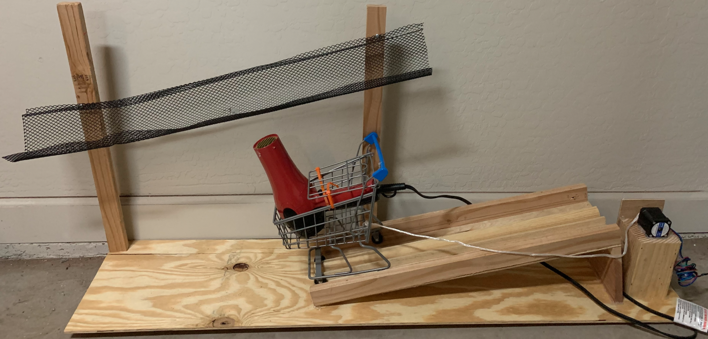
Labeled Image
Hair Dryer
Ramp
Stepper Motor
Net
Cart
Base
Chain
Figure 1: Hair Dryer Step
Jassem Alhaddad

Slide 5
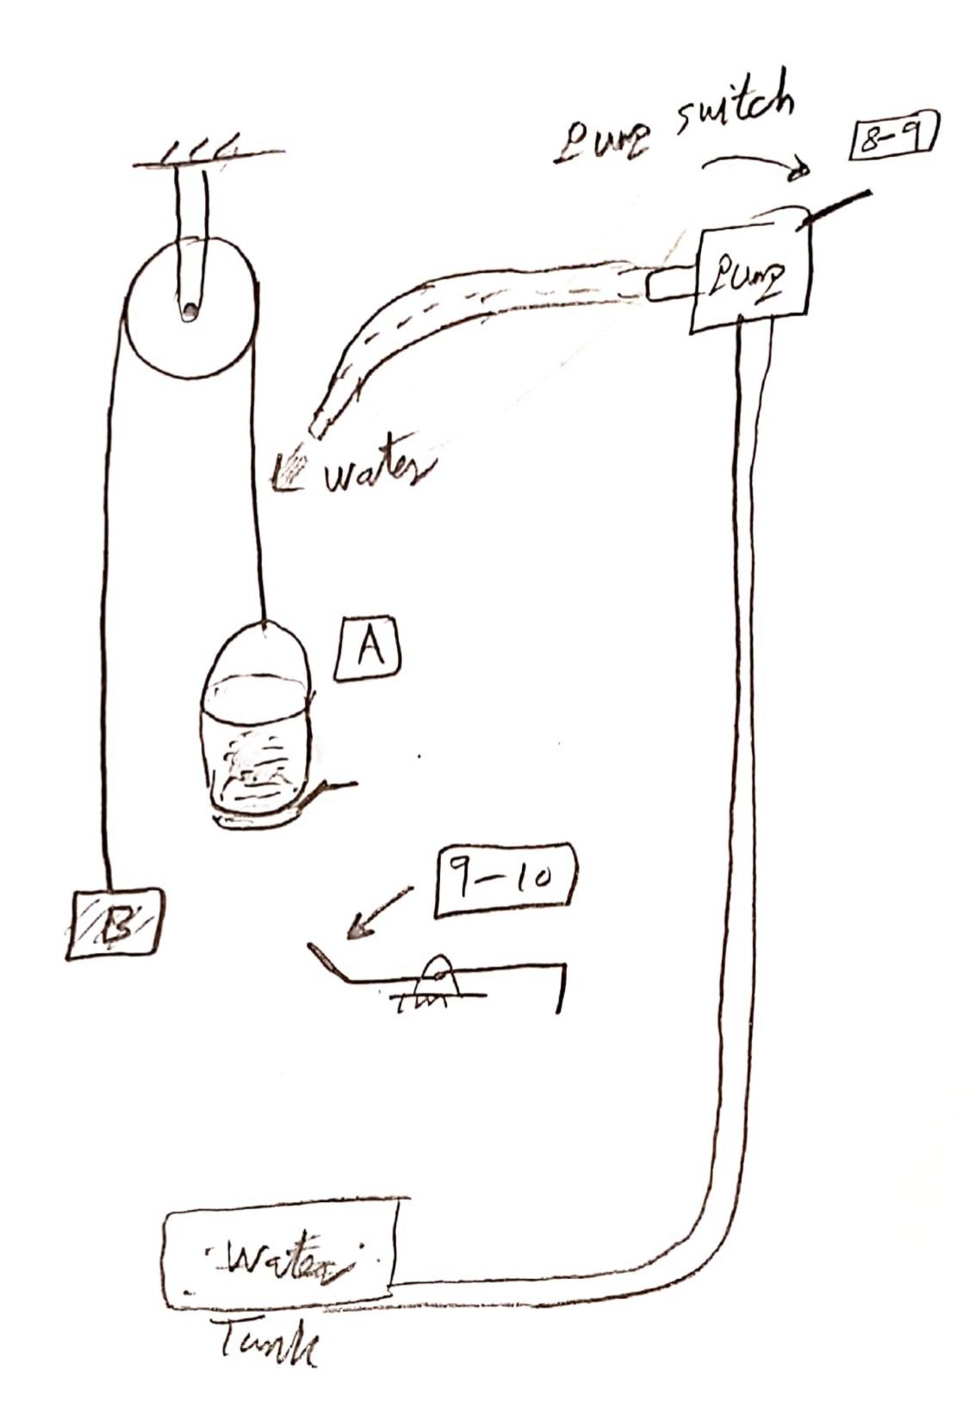
Labeled Image
Figure 2: Water Fills a Tank Step
Jassem Alhaddad

Slide 6
Updates
What has been accomplished since last semester
Where there any changes to the design? What caused those changes?
Provide visual evidence of the differences between the
Summer 19 proposed design and now
Ali Almari

Slide 7
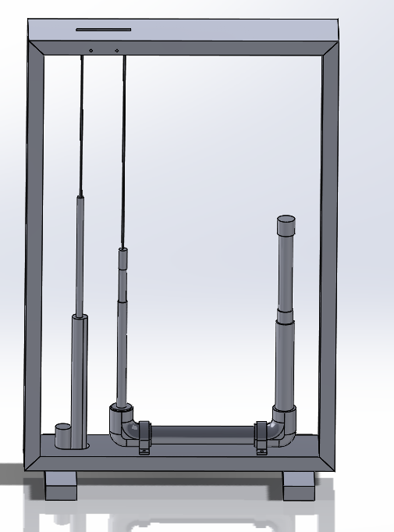
CAD Model
Ali Almari

Slide 8
Moving Forward
Discuss the new Analytical Analyses for your project and how they affected your design
What is left in the manufacturing of the design?
Detailed plans for testing the design.

Slide 9
Dominos
Put more dominos to allow the hammer to reach the nearest one.
Connect the stepper motor to dual motor driver.

Slide 10
Snail Cam
3D print the snail cam in library.
Torsional spring instead of spring.
Stepper motor to make the cam rotates.

Slide 11
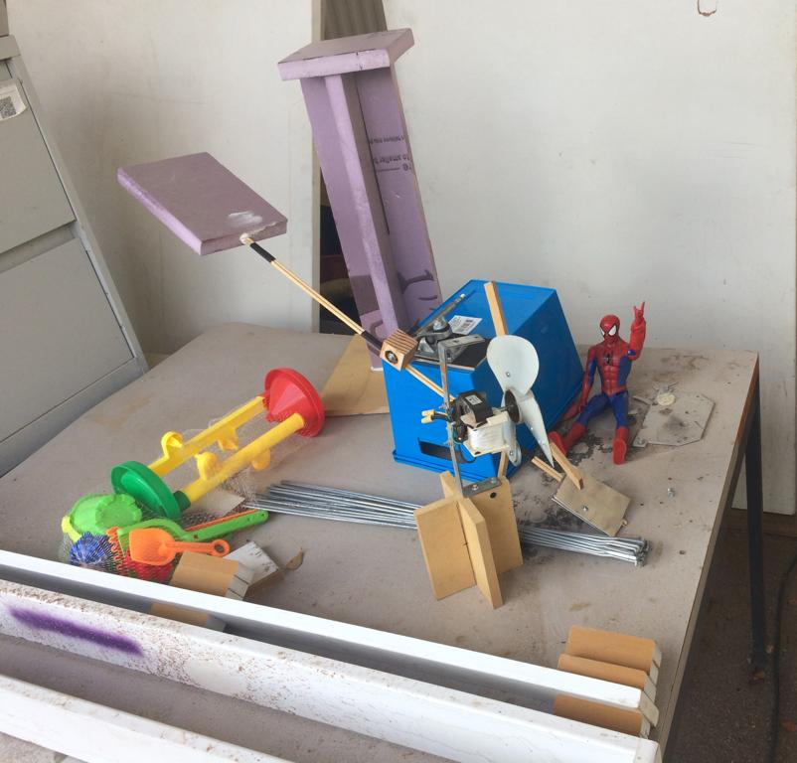
Labeled Image
Figure 3: lever

Slide 12
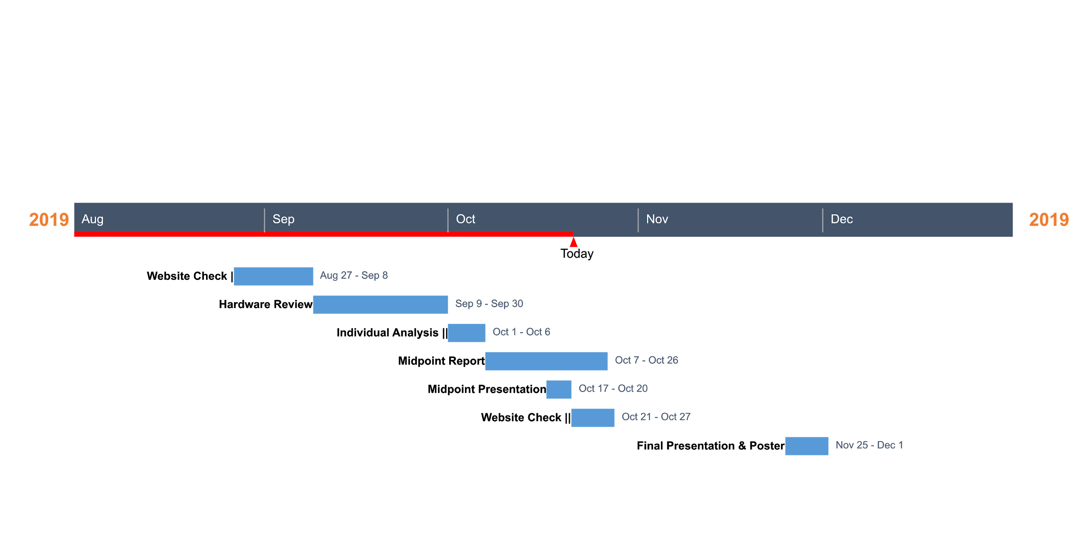
Schedule
Gantt Chart

Slide 13
Budget
Expense Details | Cost
Total Budget | 1500
Anticipated Expenses | 1000
Actual Expenses | 489.30
Resulting Balance | 1010.7
We are currently on schedule

Slide 14
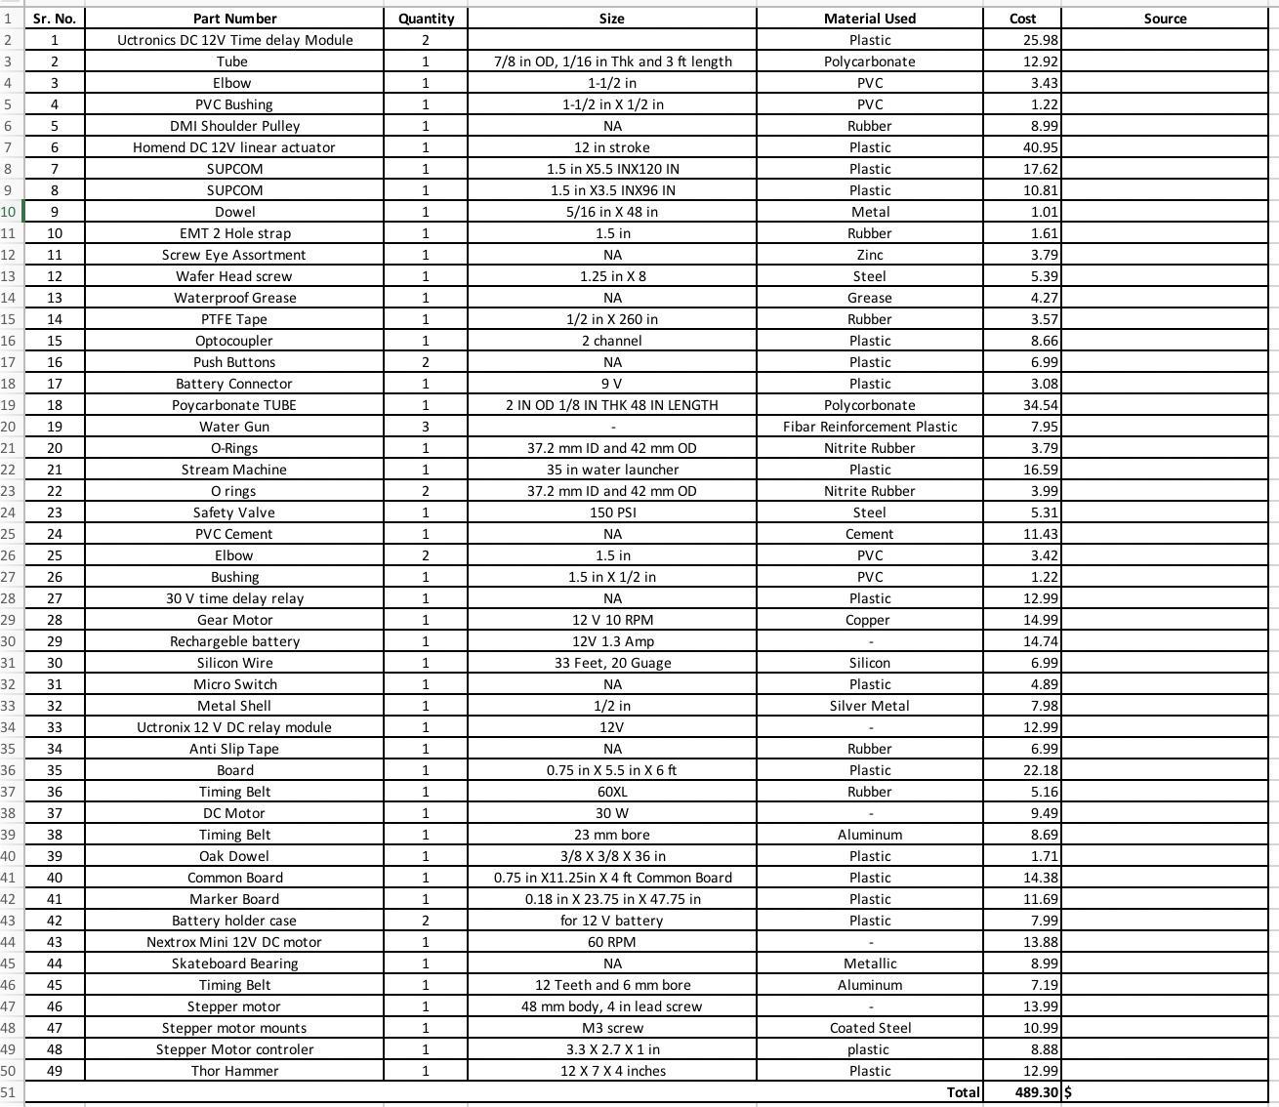
BOM

Slide 15
References
[1]BarD Software s.r.o, “Build - GanttProject Docs,” Ganttproject.biz, 2018. [Online].
https://docs.ganttproject.biz/development/build/
‌
[2]“Rube Goldberg – Home of the Official Rube Goldberg Machine Contests.” Rubegoldberg.Com, 2018, www.rubegoldberg.com/. Accessed 11 July 2019.
[3]Nau.Edu,2019,nau.edu/visual-identity-guide/wp-content/uploads/sites/121/2018/09/NAU_Acronym_Horiz_1Line-281_3514-1024x50.png. Accessed 11 July 2019.
Build native PowerPoint timelines online. (n.d.). Retrieved from https://online.officetimeline.com/app/#/file/6399a039-18ea-4125-a30c-e2b765eb7412/gantt-view.
‌

Slide 16
Questions?

